Slide 1
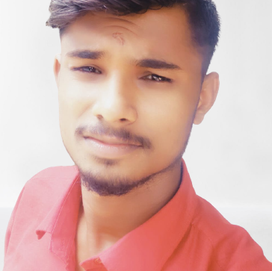


SHIVARAJA G R
Analyst/Software Engineer
Bachelor of Technology
Mechanical & Eng. :2016-2020
Skills Core Java
Spring Boot
Spring MVC
JPA CRUD.
Web Technologies
HTML5
CSS3
JavaScript
Add-ons
GitHub
Postman
Additional Details
Leadership
Motivator
Communication Skills
Team management
Bangalore
shivaraja.g-r@capgemini.com
+91 8197966918
A4
Proficient in JAVA and OOPs concepts.
Hands on experience in creating Web Application with Spring boot , Java, Rest API, React.
Hands on experience in developing web pages using HTML5, CSS3, Object Oriented Programming, JSON, XML. Good understanding of Document Object Model (DOM) and DOM Functions.
Beginning stage in creating Web Application in React with Authentication with routing.
Interested in Testing Automation and Manual and Selenium.
Movie Ticket Booking Application
Completed end to end case study of Movie ticket booking application System . along with API Gateway, Swagger,Postman, responsive UI with HTML5, CSS, Bootstrap and React used as User Interface.
HTML CSS JAVA SCRIPT for web developers at Great lerning.
Completed this course with 70% and learning how to develop some websites with the help of Html an css and Java script and React.

